Slide 1
Community Health Boards & Food Security
Food Summit, 2016
John Burka, Chair, Central Kings Community Health Board
Johanna Kwakernaak, Chair, Western Kings Community Health Board

Slide 2
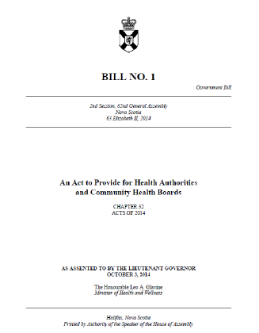
What is a Community Health Board?
37 in NS – 5 in Annapolis Valley
Notes:
“The objects of a community health board are to advise the provincial health authority
on local perspectives, trends, issues and priorities, and to contribute to health-system accountability
by facilitating an exchange of information and feedback between the community and the provincial
health authority.

Slide 3
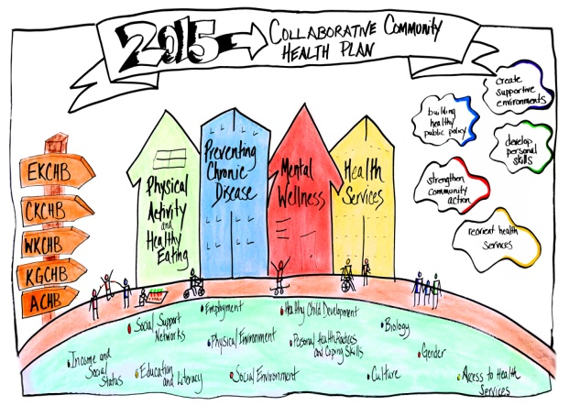
Community Health Plans
Identify local trends and issues through public engagement, health status data, and community stories.
Report to the NSHA
Notes:
One of our mandated roles is to create a Health Plan which identifies the trends and issues in our communities, and some recommendations towards addressing these issues.
Our community identified 4 priorities:

Slide 4
Population Health and Social Determinants of Health
“Health (Health Status) is largely determined by factors OUTSIDE the health care system:
  Income & Social Status
  Social Support Networks
  Education & Literacy
  Employment & Working conditions
  Social Environments
  Physical Environments
  Personal Health practices and coping skills
  Health Child Development
  Biology & Genetic Endowment
  Health Services
  Gender
  Culture
Notes:
We address the issues from a Population Health approach – that is, and as is outlined in the Act, we approach our work with an understanding that many social and economic factors effect the health status of the population, and we look at improving the conditions in the community.

Slide 5
How do we fulfill our role?
  Advocacy
  Health Promotion
  Public Engagement
    work to engage communities and populations around Health Planning and Health Plan Priorities
    Identify needs/gaps
  convene community partners by hosting/organizing networking opportunities
  With NSHA, distribute Wellness Funds to community groups that advance health promotion initiatives in the community

Slide 6
Promoting Food Security in our Communities
Some of the community partners that have come together through our work promoting food security:
NSHA: Other CHBS; Public Health Nutritionists/Health Promoters; Dieticians; Mental Health Programs
PeopleWorks/Annapolis Valley Work Centre
VCLA, Kids Action Program,
Health Eating in Recreational and Sports Settings (HERSS)
Acadia University; School Breakfast Programs; Farm to School; NSCC
Towns and Villages - Recreation, Community Gardens, Policy makers
Farmers and Farmers Markets
CMHA; Open Arms; Food Banks
VON,
FarmWorks, retail production facilities (Pie-R-Squared, etc ...)
........

Slide 7
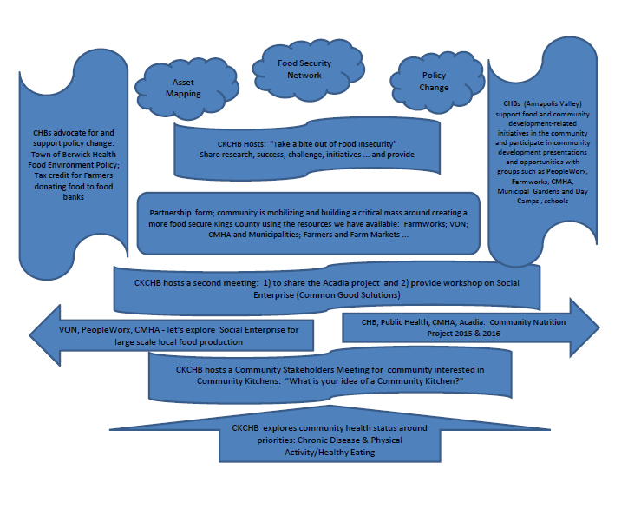

Slide 8
Questions?
ckchb@nshealth.ca
wkchb@nshealth.ca

