Slide 1

Food Labelling 101
August 2014 Wolfville , NS

Slide 2
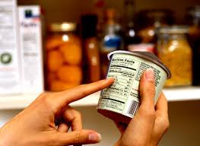
What’s on a label?
A label serves three primary functions:
Basic product information
common name;
list of ingredients;
net quantity;
durable life date;
name and address of producer
sometimes, grade/quality and country of origin.
Health, safety, and nutrition information
allergen information
nutrition information
special dietary use
safe storage and handling
Marketing, Promotion and Advertising

Slide 3

What needs a label?
Primarily, 2 Acts manage food labelling:
Food and Drugs Act (FDA)
Consumer Packaging and Labelling Act (CPLA)
Also, can have commodity specific requirements
Must be truthful and not misleading
Most pre-packaged foods
Exemptions:
Foods for export
One bite confections
Fresh fruit and veg in clear packaging

Slide 4
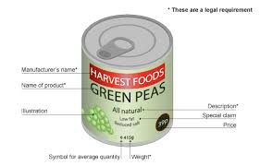
What’s on the label?
Common name
Net quantity
List of ingredients
Allergens
Place of Business
Date markings
Nutrition Facts
Bilingual
Sweeteners
Country of Origin

Slide 5
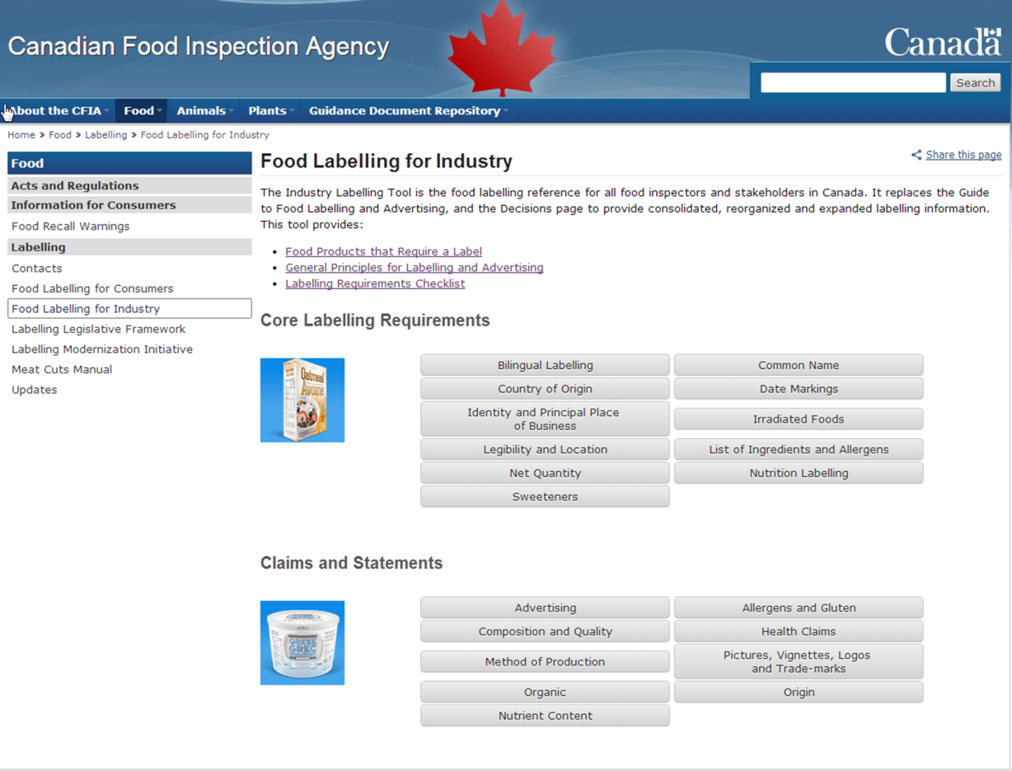
CFIA Labelling Tool

Slide 6
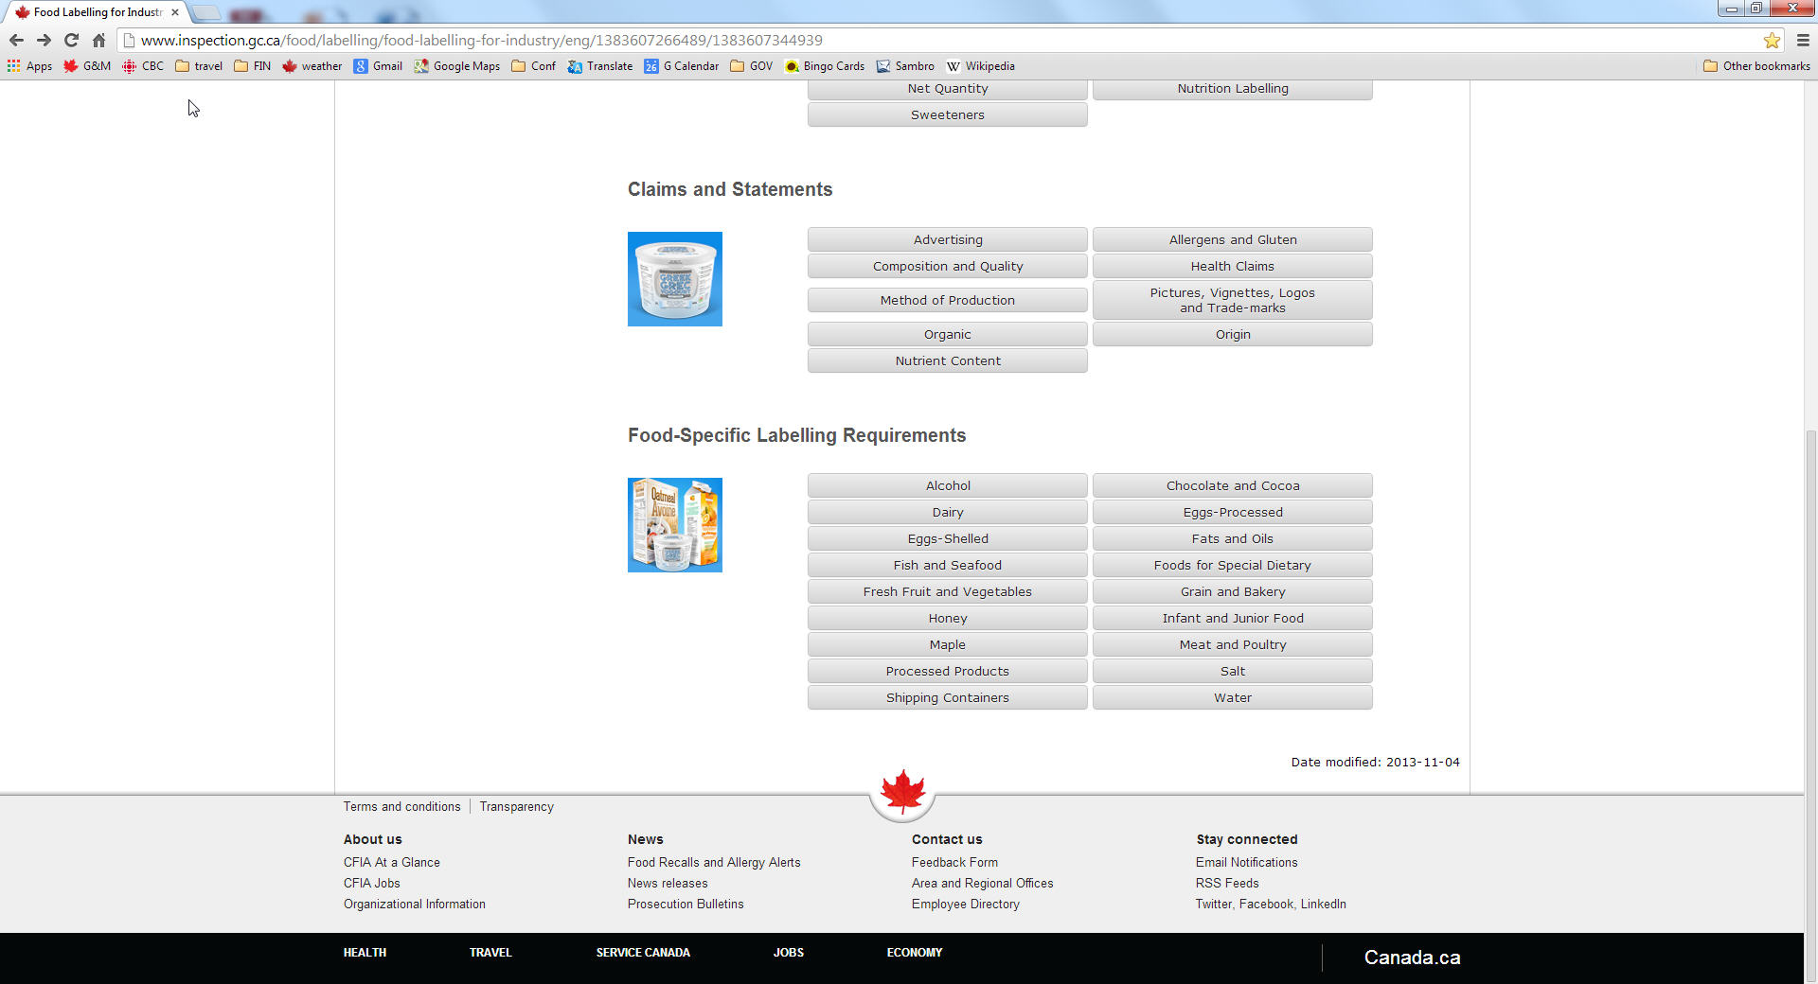
CFIA Labelling Tool

Slide 7

Common Name
Common name prescribed in regulations
Ie. Milk chocolate, cream cheese
Shown of Principle Display Panel (PDP)
minimum size 1/16 inch for small ‘o’
Exempt
Fresh fruit and veg which is clearly visible
Can use variety name ie MacIntosh

Slide 8
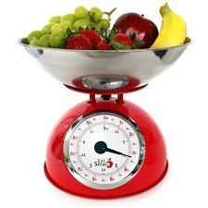
Net Quantity
Net quantity shown as:
Weight
Volume
Count
Metric units
Font size based on PDP size;
bigger the label, the larger the font

Slide 9
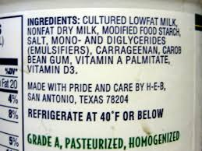
Ingredient list
Required for prepackaged foods with more than one ingredient
Exemptions
Products packaged at retail ie bulk
Single serve packages of condiments
Meat and poultry cooked at retail
Standardized alcohol beverages
Standardized vinegars
List in descending order of proportion by weight
Components declared

Slide 10
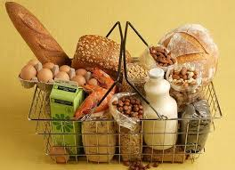
Allergens
Allergens must be declared, and source must be named
Indicated in ingredient list or a “contains” statement
Priority allergens:
Eggs, milk, mustard, peanuts, seafood, sulphites, sesame, soy, tree nuts and wheat and cereal grains containing gluten.
Exemptions:
If exempt from having a label under FDA

Slide 11

Place of Business
Declare the identity and principal place of business of the person who has produced the food
Identity: business name or owner
Place of business: physical location where food has been produced
Exemptions:
Fresh fruit and veg packaged at retail
One-bite confections

Slide 12
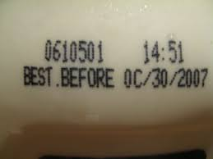
Date Markings
Prepackaged product with <91 days shelf life (other stores)
“Best before” date
Storage instructions if beyond normal room temp.
Prepackaged at retail with <91 days shelf life (in store)
“Packaged on” date
durable life on the label or displayed next to the food
Exemptions:
Prepackaged fresh fruits and veg
Prepackaged individual portions at food service
Prepackaged donuts.

Slide 13
Nutrition Facts
Mandatory for MOST prepackaged foods
Exemptions:
One bite confection
Prepackaged single serve portion at food service
Milk in refillable glass containers
No nutritive value ie. Tea, spices, bottled water
Fresh fruit and veg
Raw single ingredient meat and poultry except ground
Raw single ingredient fish
Foods prepared at retail from ingredients ie BBQ chicken
Foods sold by producer at street markets

Slide 14
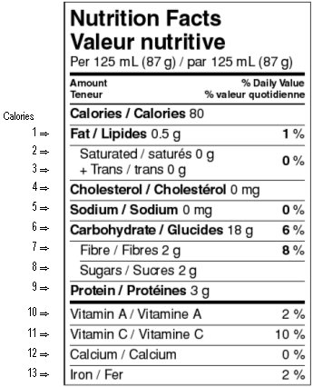
Nutrition Facts
Mandatory Information

Slide 15
Nutrition Facts
Prescribed formats:
Based on size of available display surface
how is food eaten
Example formats:
Standard, horizontal, linear
Simplified ie >7 nutrients = 0 eg. diet soda, drink mix powder
Dual ie food needing preparation eg. breakfast cereal
Aggregated ie assorted products same package eg. granola bars

Slide 16
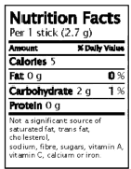

Non-standard formats
Simplified
Linear

Slide 17
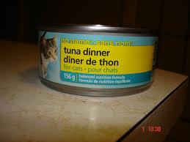
Bilingual
All mandatory information in both languages except place of business which can be either EN/FR
Exemptions:
Shipping Containers: commercial, not meant for consumers
Specialty Foods: imported foods with no local substitute
Local Foods: Sold in home municipal unit
Test Market Foods

Slide 18
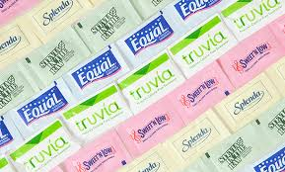
Sweeteners
Use of artificial sweeteners, triggers special labelling requirements
Additional statements along with ingredient list and Nutrition Facts

Slide 19

Country of Origin (COOL)
COOL is required for:
wine and brandy
dairy products
honey
fish and fish products
fresh fruits and vegetables
shelled egg
processed egg
meat products
maple products
processed fruit and vegetable products

Slide 20

Product of Canada (PoC)
Product of Canada = virtually all major ingredients, processing, and labour used to make the food product are Canadian
Made in Canada (MiC) requires a qualifying statement
MiC with imported ingredients
MiC with imported and domestic ingredients
“Canadian” and “100% Canadian” same standard as PoC

Slide 21
Thank you
Find more information at:
http://www.inspection.gc.ca/food/labelling/labelling-legislative-framework/eng/1387771371233/1387771427304
http://www.inspection.gc.ca/food/labelling/food-labelling-for-industry/eng/1383607266489/1383607344939
Darren Leyte
Health Canada
Darren.leyte@hc-sc.gc.ca
902-426-6129

