Slide 1

Paul Gérin
Business Development Officer
Toni Kearney
Assistant Information/Outreach Officer

Slide 2






Our Services
FREE and reliable, we are proud to offer the following:
Business information
and referrals
Province-wide
bilingual service
Comprehensive
national website
Access to government
programs and services
Business planning
tools and resources
Financing
information

Slide 3
Market Research
We can help you find…
Industry performance and consumer trends
Critical analysis, statistics and forecasts
Demographics
Suppliers of product
SWOT analysis (strengths, weaknesses, opportunities, threats)
Economic data and analysis
Consumer spending habits
Brand and company market share data by product industry
Starting or expanding a business can be overwhelming, let us help you find the information you need!

Slide 4
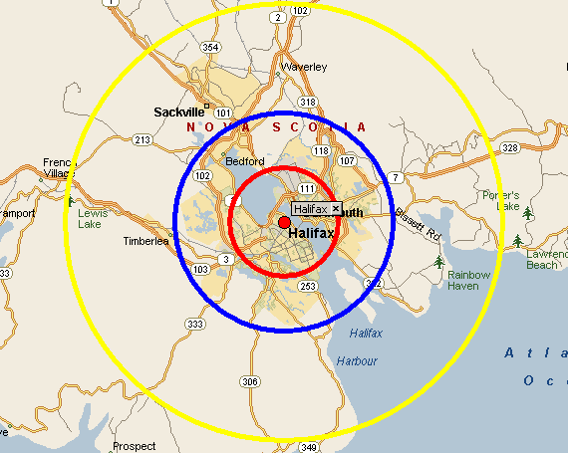
Your Customers
We can help you answer these questions:
Who are my customers and where do they live?
How old are my customers and what is their average income?
How much do they buy annually or monthly?
Why do they buy?
Where is the ideal location for my business?

Slide 5

Your Competition
We can help you understand your competition
Who is my indirect and direct competition?
What is their annual revenue?
Where are they located?
How many employees do they have?

Slide 6

Industry Intelligence
We can help you better understand your industry
Find companies that can supply the goods, services and technology you need
Find potential partners, distributers, and suppliers
Boost awareness of your company or organization by making new connections
Resources include the Canadian Company Capabilities database and statistics from Industry Canada

Slide 7
Your Business
We are here for you every step of the way!
Start-up
Growth
Expansion
Maturity
Transition

Slide 8

Canada Business
Let us be your first point of contact for information on…
Business structures
Copyrights, patents, and trademarks
Government regulations
Taxation
Sample business plans
Permits and licensing
Financing information
Market & industry research
Importing & exporting
Human resources

Slide 9
Industry Scenario: Restaurant
So you want to open a restaurant?
Industry report IBIS World and Passport
Industry financial performance Industry Canada
Demographic data PCensus
Sample business plans and documents Business Plan Pro and Business in a Box

Slide 10




Stay Connected
Feel free to contact us anytime!
Cindy Allen
Communications Officer 902-426-6286
Cindy.Allen@canada.ca
Paul Gérin
Business Development Officer 902-426-7377
Paul.Gerin@canada.ca
/CanadaBusinessNS
RSS Feed via website
@CanadaBusiness
Sign up for our e-newsletter!

